Slide 1
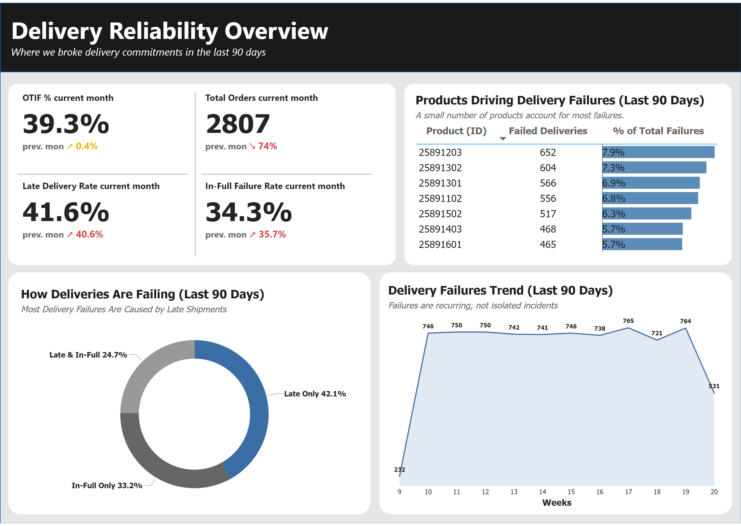
Page 1
Notes:
cardVisual
No alt text provided
shape
No alt text provided
shape
No alt text provided
shape
No alt text provided
shape
No alt text provided
shape
No alt text provided
shape
No alt text provided
textbox
No alt text provided
shape
No alt text provided
shape
No alt text provided
shape
No alt text provided
Products Driving Delivery Failures (Last 90 Days)
No alt text provided
Delivery Failures Trend (Last 90 Days)
No alt text provided
How Deliveries Are Failing (Last 90 Days)
No alt text provided

